Slide 1
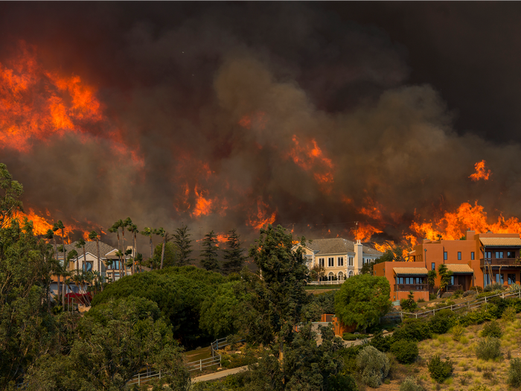
National University
ANA 699C
Wildfires: The Effects on Southern California
A Team
(Aakriti Sinha, Adam LeBlanc, Aditi Bhujbal, Anna Mkrtchyan)
Date: Nov 11, 2022

Slide 2
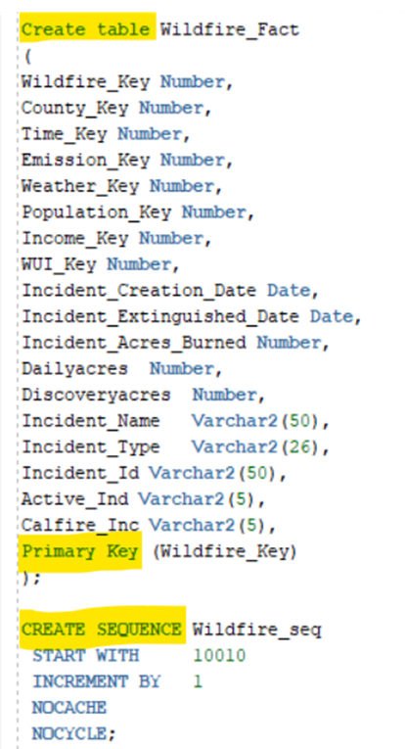
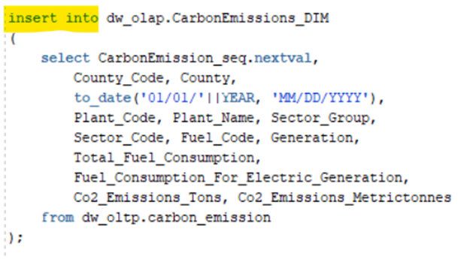
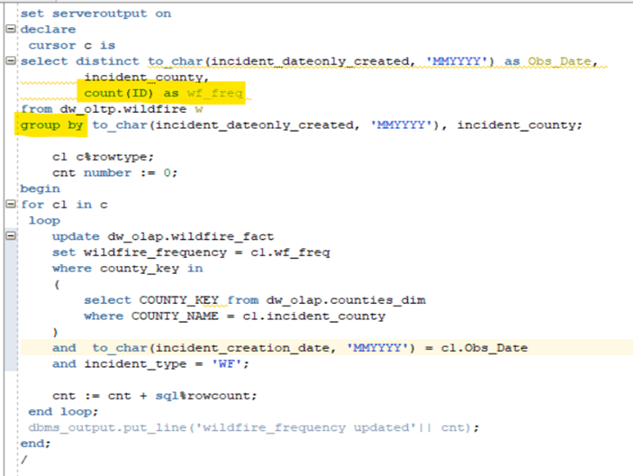



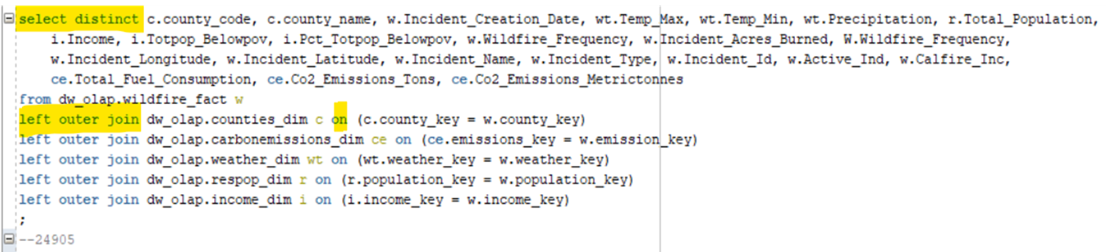
Process of inserting data into and exporting the master data from data mart involved writing several sql queries that included joins and subqueries along with a PL/SQL script.
Notes:
Aditi
To create Fact and Dimension tables.
To insert the data into fact and dimension tables.
To update wildfire_frequency from unique records
To select unique records from wildfire fact and corresponding details from all dimension tables.

Slide 3
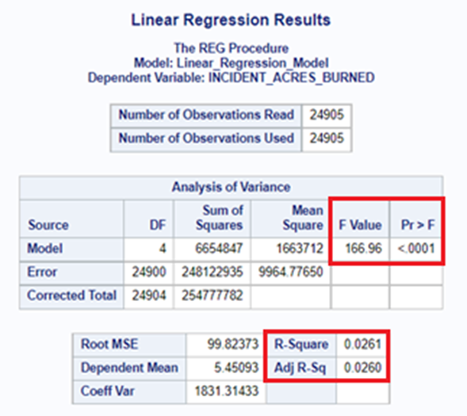
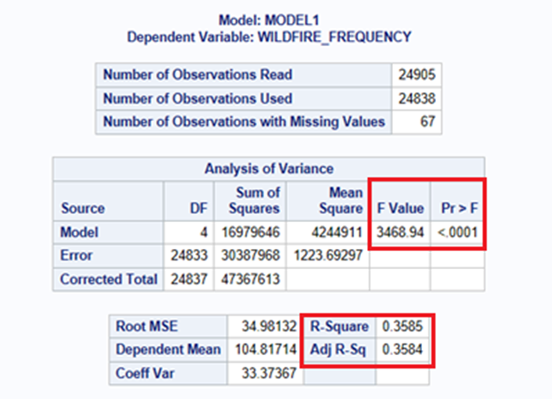
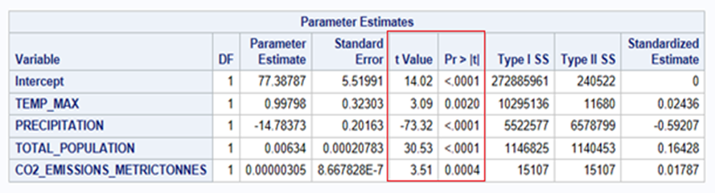
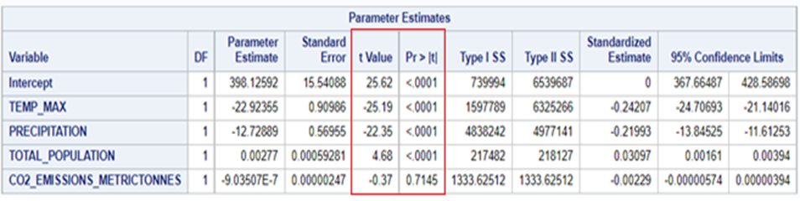
Multilinear model and t-test criteria produced the results that determined variation in outcome variables explained by explanatory variables.
Notes:
Aditi
Top left corner image: According to adjusted R-square, 35.84% of variation in wildfire_frequency is explained by all the selected explanatory variables together.
Bottom left corner image: According to t-test, Temperature, Population, and Carbon emission are positively correlated to wildfire_frequency, whereas precipitation is negatively correlated. The largest absolute t-value of precipitation shows that it is the strongest predictor of wildfire_frequency.
Top right corner image: According to adjusted R-square, 26% of variation in outcome variable Incident_Acres_Burned, is explained by all the selected explanatory variables together. Incident_Acres_Burned is representing the severity of wildfires.
Bottom right corner: According to t-test, Temperature, precipitation, carbon emission are negatively correlated to wildfire severity, however carbon emission is not a significant predictor of severity because p-value > 0.05. On the other hand, Population is positively correlated with outcome variable incident_acres_burned and the correlation is statistically significant, it is still not the lead contributor to the prediction of wildfire severity due to its lowest absolute value of t-test criteria.

Slide 4
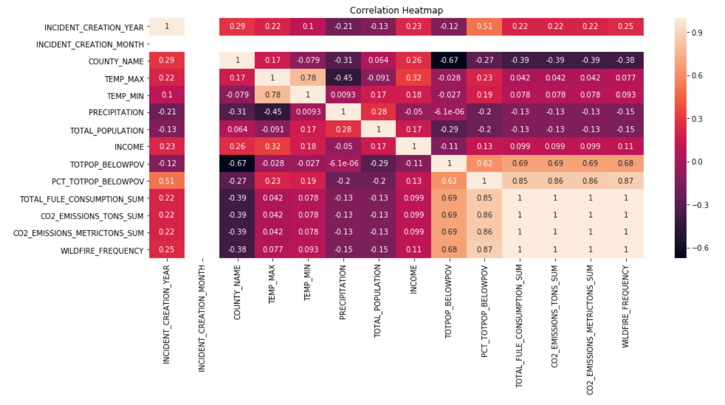
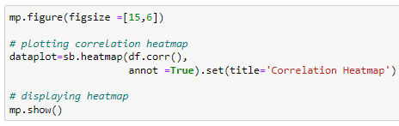
Seabonrn python package was used to create correlation heatmap for all the variables in the dataset.
Notes:
Anna

Slide 5
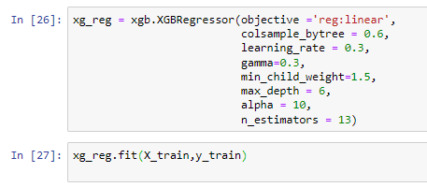
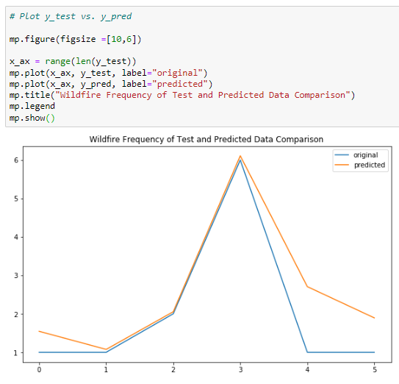
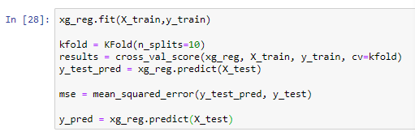
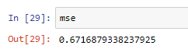
The XGBRegressor function produced a predicting model for wildfire frequency with mean-squared error of 0.67.
Notes:
Anna

Slide 6
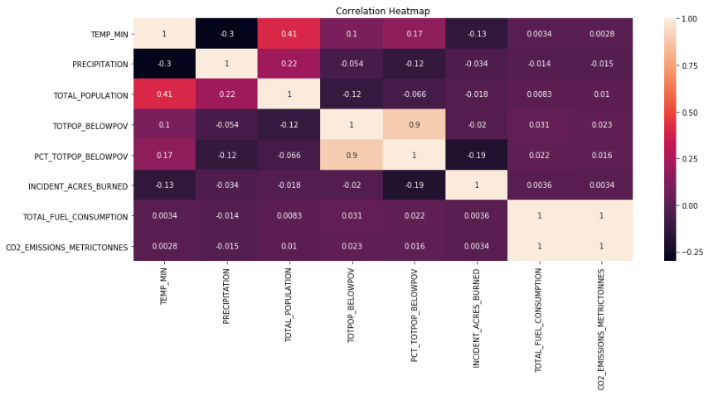
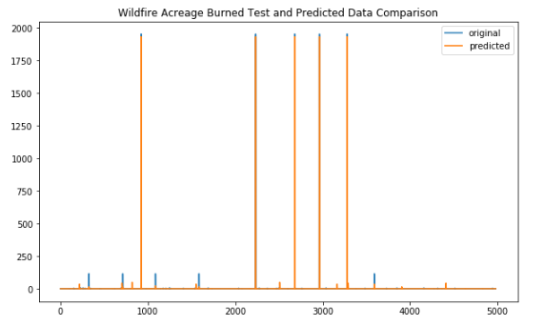

Prediction model (XGBoost) of Wildfire Severity and Results
Notes:
Aakriti

Slide 7
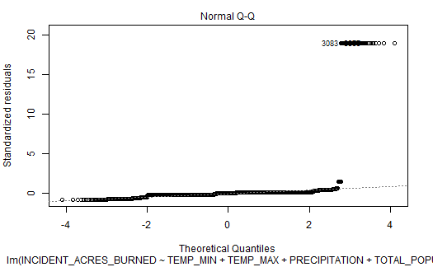
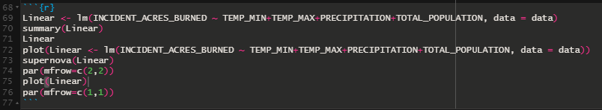
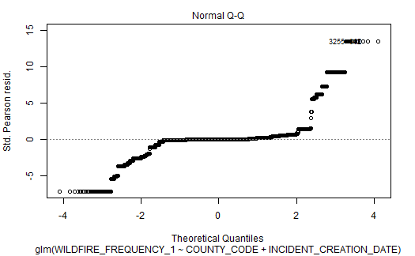
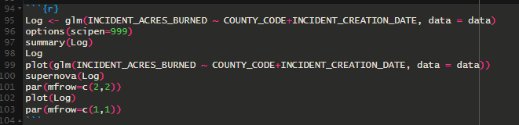
Analysis and Regression models were built and analyzed with R - code using ggplot and ggformula packages.
Notes:
Adam

Slide 8
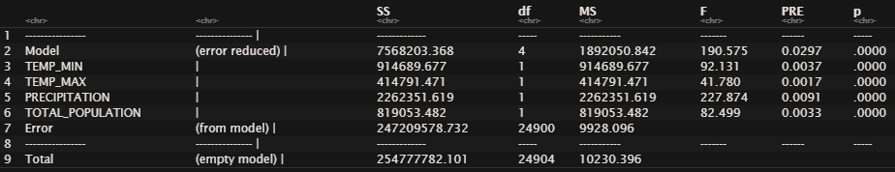

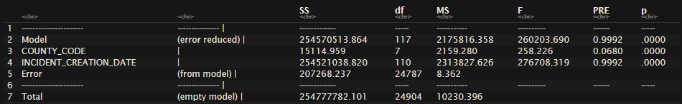
The results and interpretation of regression models using the supernova and dplyr packages.
Linear Regression example
Logistic Regression example
Notes:
Adam

Slide 9
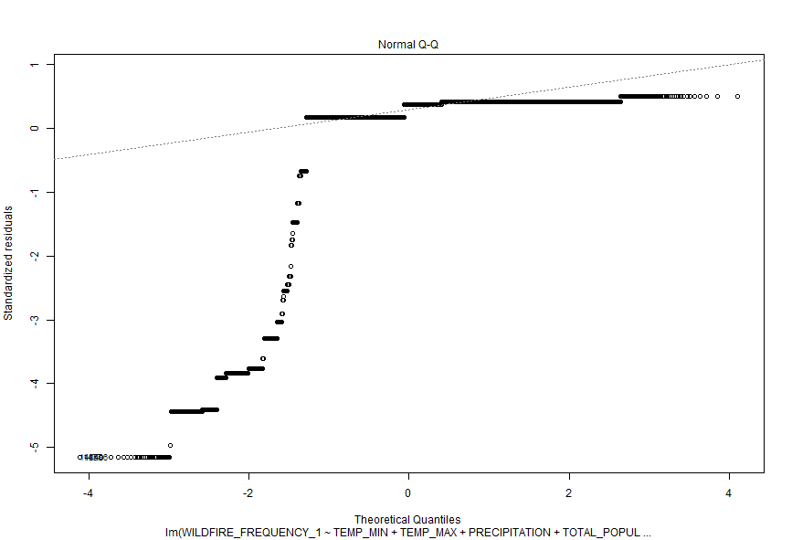
The conclusion is XGBoost outperformed Regression models but both have the same conclusion supporting the research question.
Regression
<
XGBoost
Notes:
Adam

Slide 10





Limitations recognized based on Thesis results.
Other Gasses
Census & WUI
Variable Exclusion
Non-reported Wildfires
Notes:
Aakriti

Slide 11




Recommendations suggested based on Thesis results.
AET
Variable
Adding Limitation Data
Replication
Notes:
Aakriti

Slide 12
References:
Harris, Lucas & Drury, Stacy & Farris, Calvin & Taylor, Alan. (2021). Prescribed fire and fire suppression operations influence wildfire severity under severe weather in Lassen Volcanic National Park, California, USA. Retrieved from : https://www.researchgate.net/publication/351154560_Prescribed_fire_and_fire_suppression_operations_influence_wildfire_severity_under_severe_weather_in_Lassen_Volcanic_National_Park_California_USA
Telang P. (Nov 2021). What is the Objective of Exploratory Data Analysis? Tech Canvas. Retrieved from https://businessanalyst.techcanvass.com/objective-of- exploratory-data-analysis/
How to Deal with Missing Data? (2022). Master’s in Data Science. Retrieved from https://www.mastersindatascience.org/learning/how-to-deal- with-missing-data/
Patil P. (Mar 2018). What is Exploratory Data Analysis? Towards Data Science. Retrieved from https://towardsdatascience.com/exploratory-data-analysis-8fc1cb20fd15
Questions?

